Slide 1
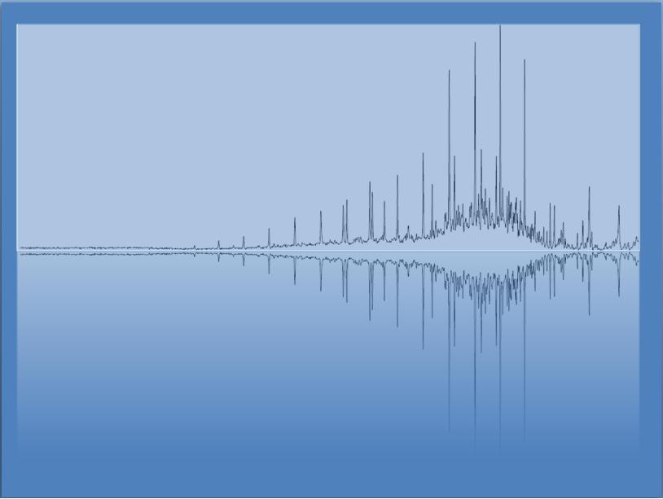
Gases
Chem 3A- Yates

Slide 2
Outline
Kinetic Molecular Theory of Gases/Ideal Gas Law
Dalton’s Law of Partial Pressures
“Challenging” Gas Calculations

Slide 3
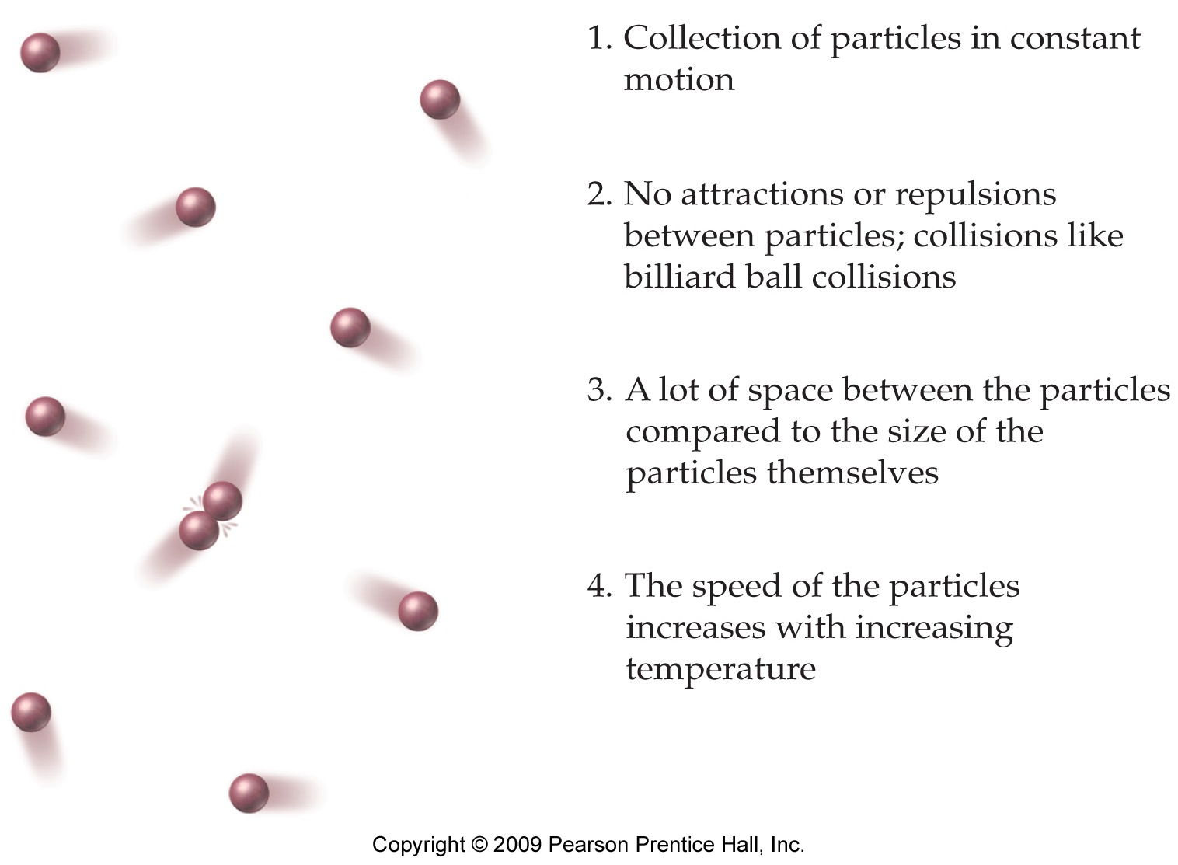
Kinetic Molecular Theory of Gases

Slide 4
Some Quick Notes
Standard Temperature and Pressure (STP) =>Common reference points for comparing
Standard pressure = 1.00 atm
Standard temperature = 273.15 K
*Always use Kelvin Temperature in Gas Calculations
K = °C + 273.15

Slide 5


When to use each form
Use this form when you know a lot of information about one situation.
Use this form when you are comparing two situations, such as before and after a change.
You can cross out variables that remain constant.

Slide 6
Class Activity
In your group, each take turns looking at a question the old exam (on screen next).
Is this a question specifically about gases?
Would it use one of the forms of the ideal gas law? If so, which one?
If so, write down that form of the ideal gas law and rearrange the variables to solve for what is needed. (Talk through how to do it out loud- Be sure to review algebra skills with your group.)
Last (out loud) remind your group. “Always convert to Kelvin temperature with Gas Calculations”

Slide 7
Let’s pick a couple problems and work on them together

Slide 8
Outline
Kinetic Molecular Theory of Gases
Ideal Gas Law
Dalton’s Law of Partial Pressures
“Challenging” Gas Calculations

Slide 9
Partial Pressure
Each gas in the mixture exerts a pressure independent of the other gases in the mixture.
The pressure of a component gas in a mixture is called a partial pressure.
The sum of the partial pressures of all the gases in a mixture equals the total pressure.
Dalton’s law of partial pressures.
P_{total} = P_{gas A} + P_{gas B} + P_{gas C} +...

Slide 10
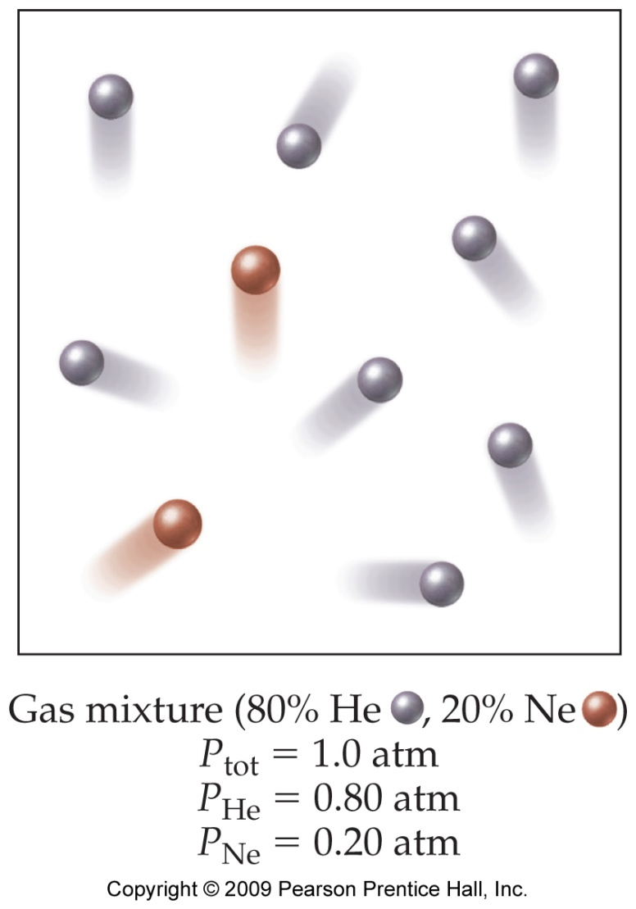
Finding Partial Pressure
To find the partial pressure of a gas, multiply the total pressure of the mixture by the fractional composition of the gas.
For example, in a gas mixture that is 80.0% He and 20.0% Ne that has a total pressure of 1.0 atm, the partial pressure of He would be:
P_{He} = (0.800)(1.0 atm) = 0.80 atm
Fractional composition = percentage divided by 100.

Slide 11
The Partial Pressure of Each Gas in a Mixture, or the Total Pressure of a Mixture, Can Be Calculated Using the Ideal Gas Law
11

Slide 12
Outline
Kinetic Molecular Theory of Gases
Ideal Gas Law
Dalton’s Law of Partial Pressures
“Challenging” Gas Calculations

Slide 13
Practice—Calculate the Density of a Gas at 775 torr and 27 °C if 0.250 moles Weighs 9.988 g.
13

Slide 14
Molar Mass of a Gas
One of the methods chemists use to determine the molar mass of an unknown substance is to heat a weighed sample until it becomes a gas, measure the temperature, pressure, and volume, and use the ideal gas law.

Slide 15
Example: A sample of a gas has a mass of 0.311 g. Its volume is 0.225 L at a temperature of 55 °C and a pressure of 886 mmHg. Find its molar mass.

